Slide 1
Exception Handling in Java
Exception handling in Java is a mechanism to handle runtime errors, allowing the program to continue executing rather than abruptly terminating when an error occurs.
An Exception is an unwanted or unexpected event that occurs during the execution of a program (i.e., at runtime) and disrupts the normal flow of the program’s instructions.
Java provides a robust system for catching and handling exceptions through a combination of try, catch, throw, throws, finally blocks and Custom Exception handling.
Examples….??

Slide 2
Why Exception Handling is Needed in Java:
Graceful Error Handling: Without exception handling, if an error occurs, the program will terminate abruptly, and no further processing can be done. With exception handling, you can catch errors, display meaningful messages, and ensure the program doesn't just crash. This improves the user experience and system reliability.
Separation of Error-Handling Code: With exception handling, error-handling code can be separated from the regular business logic. This leads to cleaner and more maintainable code, as the main flow isn't cluttered with error checks.
Recover from Errors: By catching exceptions, you can decide on actions to recover from errors. For example, if a file is not found, you might prompt the user to select a different file, or you could try accessing an alternate source of data.
Debugging and Logging: Exceptions can provide detailed information about what went wrong, including the type of exception and the stack trace (i.e., where in the code the exception occurred). This information is useful for debugging and diagnosing issue

Slide 3
Prevent Program Crashes: Exception handling helps prevent unexpected crashes by catching issues at runtime, ensuring that the program can handle them gracefully without exiting unexpectedly.
Maintainability: Handling errors in a structured way with try-catch blocks and exception classes makes it easier to modify or extend the code. New types of errors can be added without affecting the rest of the code.
Custom Exceptions: Java allows developers to create custom exception classes to represent specific error conditions unique to their application, providing more meaningful and precise error handling.

Slide 4
Java Exception Hierarchy
All exception and error types are subclasses of the class Throwable, which is the base class of the hierarchy.
One branch is headed by Exception. This class is used for exceptional conditions that user programs should catch. NullPointerException is an example of such an exception.
Another branch, Error is used by the Java run-time system(JVM) to indicate errors having to do with the run-time environment itself(JRE). StackOverflowError is an example of such an error.

Slide 5
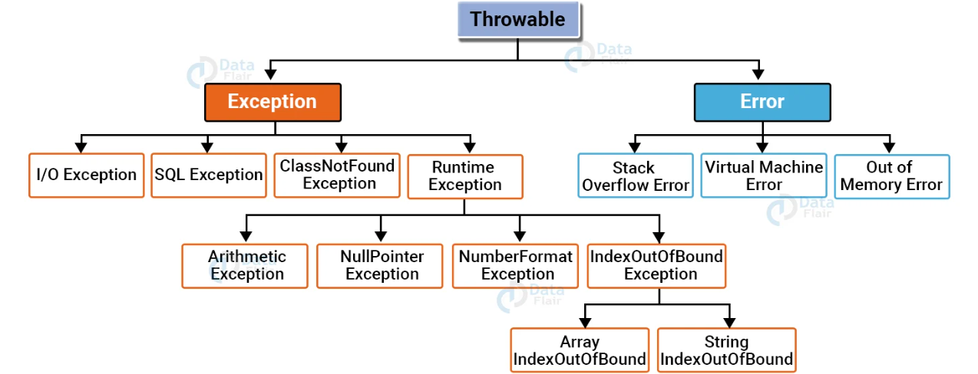

Slide 6
Types of Exception
1. Checked Exception
2. Unchecked Exception
3. Error

Slide 7
1. Checked Exception in Java: The exception classes which directly inherit from the Throwable class with an exception of RuntimeException and Error are checked exceptions. They are checked during compilation time. For example: IOException, SQLException, ClassnotFound, etc.
2. Unchecked Exception in Java: The exception classes inheriting the RuntimeException class are unchecked exceptions. They are not checked at compilation time but during runtime. For example: ArithmeticException, IndexOutOfBOundException, etc.
3. Error in Java: The exceptions which are irrecoverable are known as errors. They are also checked at runtime. For Example: OutOfMemoryError, VirtualMachineError, etc.

Slide 8
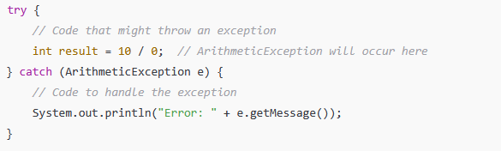
Basic Syntax of Exception Handling in Java:
Try-Catch Block: This block is used to catch exceptions during runtime.

Slide 9
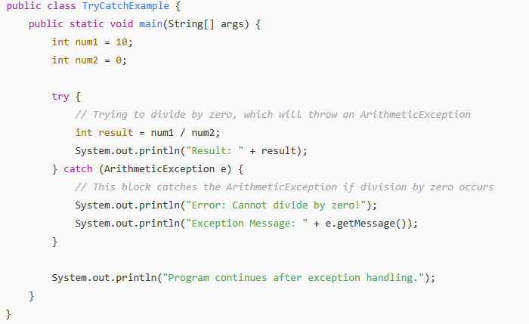
Explanation:
try block:
The code inside the try block is executed. Here, we attempt to divide num1 (10) by num2 (0), which will throw an ArithmeticException because division by zero is not allowed in Java.
catch block:
If an exception occurs in the try block, the control is passed to the catch block. In this case, catch (ArithmeticException e) catches the ArithmeticException thrown by the division by zero.
The catch block handles the exception by printing a friendly error message and the exception's message.
Program Continuation:
After handling the exception, the program continues execution with the next statement after the try-catch blocks, ensuring that the program doesn't crash due to the exception.

Slide 10
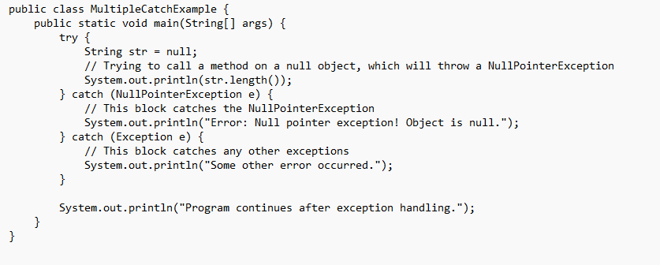
Handling Multiple Exceptions

Slide 11
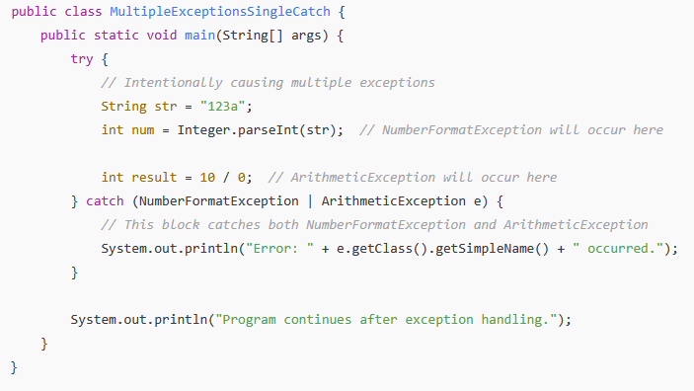
Example 3: Catching Multiple Exception Types in a Single catch Block (Java 7 and later)

Slide 12
Nested try:
In Java, you can have nested try blocks, meaning a try block inside another try block.
This can be useful when you have different levels of exception handling or when a certain block of code within a larger try needs its own specific error handling.

Slide 13
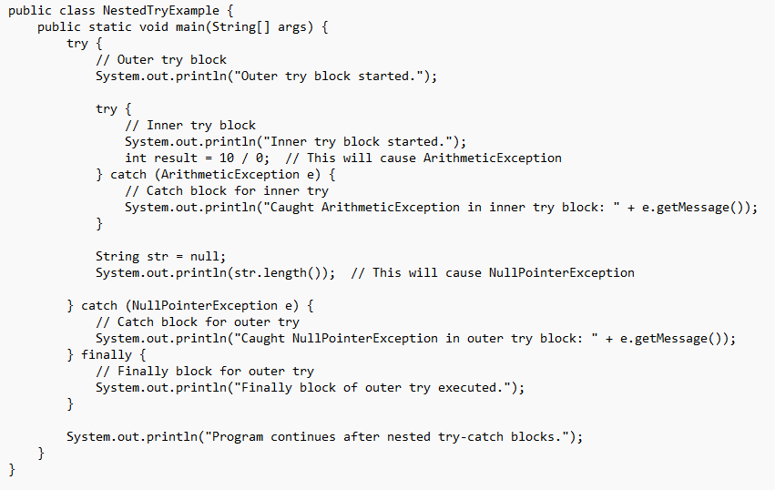

Slide 14
Throw Statement: The throw keyword is used to explicitly throw an exception.

Slide 15

Throws Statement: The throws keyword is used in method declarations to indicate that a method may throw an exception.

Slide 16
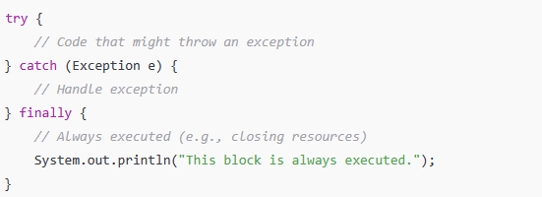
Finally Block: A finally block will always execute, regardless of whether an exception was thrown or not. It is typically used to release resources (like closing files or database connections).

Slide 17
